Slide 1


ASP.NET CORE AND ASP.NET CORE MVC
By Jafar Muzeyin

Slide 2
Dotnet CLI The command line tool for ASP.NET Core

Slide 3
Dotnet CLI
The dotnet CLI is a command-line interface (CLI) is a new tool for developing the .NET application.
It is a cross-platform tool and can be used in Windows, MAC or Linux.

Slide 4
Using Dotnet CLI
The Dot Net CLI is installed as part of the Net Core SDK. You can download the Net Core SDK from this link
The syntax of Dotnet CLI consists of three parts. The driver, the “verb”, and the “arguments”
dotnet [verb] [arguments]
The driver is named “dotnet”
The “verb” is the command that you want to execute. The command performs an action
The “arguments” are passed to the commands invoked

Slide 5
Commonly used Commands
COMMAND | DESCRIPTION
new | Creates a new project, configuration file, or solution based on the specified template.
restore | Restores the dependencies and tools of a project.
build | Builds a project and all of its dependencies.
publish | Packs the application and its dependencies into a folder for deployment to a hosting system.
run | Runs source code without any explicit compile or launch commands.
test | .NET test driver used to execute unit tests.
vstest | Runs tests from the specified files.
pack | Packs the code into a NuGet package.
migrate | Migrates a Preview 2 .NET Core project to a .NET Core SDK 1.0 project.
clean | Cleans the output of a project.
sln | Modifies a .NET Core solution file.
help | Shows more detailed documentation online for the specified command.
store | Stores the specified assemblies in the runtime package store.

Slide 6
Creating a New ASP.NET Core project using dotnet CLI
Open the command prompt or Windows Powershell and create a Folder named “HelloWorld”
dotnet new command is used to create the new project. The partial syntax is as follows
dotnet new <TEMPLATE> [--force] [-i|--install] [-lang|--language] [-n|--name] [-o|--output]

Slide 7
Create a New Project using dotnet new
The following command creates a new dotnet project using the TEMPLATE
dotnet new <TEMPLATE>

Slide 8
List of Templates
TEMPLATE | DESCRIPTION
console | Console Application
classlib | Class library
mstest | Unit Test Project
xunit | xUnit Test Project
web | ASP.NET Core Empty
mvc | ASP.NET Core Web App (Model-View-Controller)
razor | ASP.NET Core Web App
angular | ASP.NET Core with Angular
react | ASP.NET Core with React.js
reactredux | ASP.NET Core with React.js and Redux
webapi | ASP.NET Core Web API

Slide 9
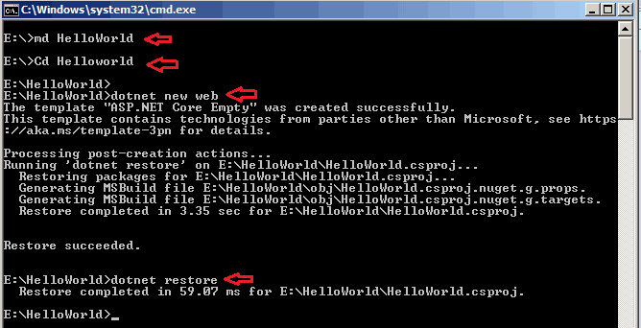
Restoring the Dependencies with dotnet restore
Once we created the new project, we have to download the dependencies. This is done using the restore command
Dotnet restore

Slide 10
Running the Application with dotnet run
Use dotnet run to start the application

Slide 11
Web app Start

Slide 12
Steps to create web application in asp.net core
Step 1 : To create a new asp.net core project in Visual Studio 2017
Step 2 : In Visual Studio click on File - New - Project.
Step 3 : In the "New Project" dialog, expand "Installed". Then expand "Visual C#" and select .NET Core
Step 4 : In the middle pane, you will find all the installed project templates. For example, you will find templates for creating .NET Console Application, Class Library, Unit Testing Projects (with MSTest, NUnit or xUnit

Slide 13
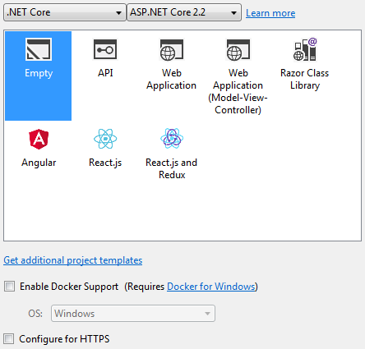
WHAT HAPPENS WHEN WE ACCESS WEB PAGE
Step 5 : We want to create "ASP.NET Core Web Application". So, select "ASP.NET Core Web Application“
Step 6 : In the "Name" textbox, type a name for your project
Step 7 : Also, specify a location where the project to be created.
Step 8 : Finally click OK.
Step 9 : On the next screen, select ASP.NET Core
Empty : The "Empty" template as the name implies does not contain any content. This is the template that we will use and set up everything manually from scratch so we clearly understand how the different pieces fit together.

Slide 14
ASP.NET Core Solution Structure

Slide 15
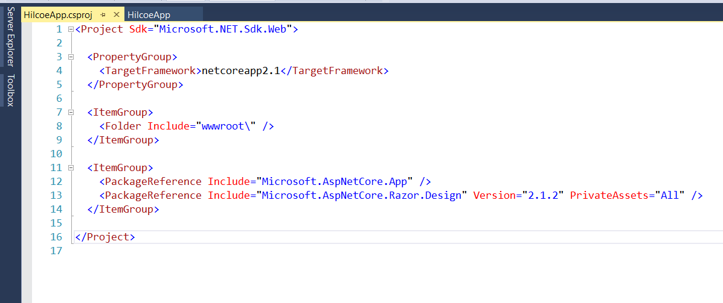
New Project Solution Structure
TargetFramework : Specifies the target framework for the application
PackageReference used to include a reference to all the NuGet packages that are installed for the
application
The current two packages available in this project
Microsoft.AspNetCore.App
Microsoft.AspNetCore.Razor.Design
Folder This element defines the Wwwroot content
folder that is designed to contain static web content.

Slide 16
Project Solution Structure
launchsettings.json file
The settings in this file are used when, ASP.NET core project run either from Visual Studio or by using .NET Core CLI.
It is only used on local development machine and not for publishing the application.
When the project run from Visual Studio, the profile with "commandName": "IISExpress" is used.
When the project run using .NET Core CLI (dotnet run), the profile with the "commandName": "Project" is used. can change which profile to use by clicking on the dropdownlist in Visual Studio
The profile can be to use by clicking on the dropdown list in Visual Studio
The settings in launchSettings.json file can be edited directly by editing the file or changing the settings using the Graphical User Interface (GUI) provided by Visual Studio.

Slide 17
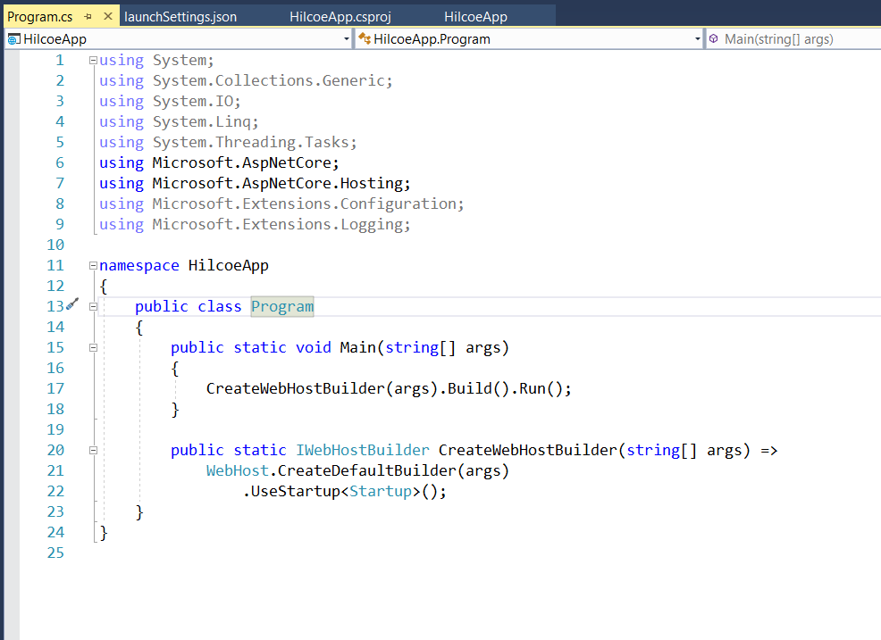
Project Solution Structure
Program.cs
The Main() method in Program.cs file is the entry point.
when the runtime executes the application looks for this Main() method and this where the execution starts.
This Main() method configures asp.net core and starts it and at that point it becomes an asp.net core web application.
The Main() method, calls CreateWebHostBuilder() method passing it the command line arguments.

Slide 18
The Startup class
ASP.NET Core apps require a Startup class. By convention, the Startup class is named "Startup".
You specify the startup class name in the Main programs WebHostBuilderExtensions UseStartup<TStartup> method.
You can define separate Startup classes for different environments, and the appropriate one will be selected at runtime
The Startup class constructor can accept dependencies that are provided through dependency injection
The Startup class must include a Configure method and can optionally include a ConfigureServices method, both of which are called when the application starts.

Slide 19
The Configure method
The Configure method is used to specify how the ASP.NET application will respond to HTTP requests.
The request pipeline is configured by adding middleware components to an IApplicationBuilder instance that is provided by dependency injection.

Slide 20
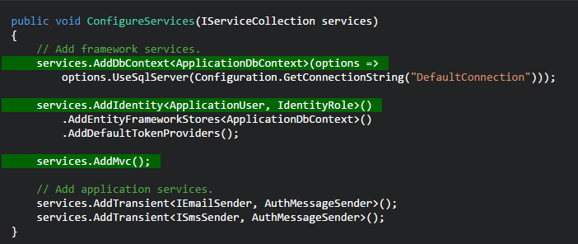
The ConfigureServices method
The ConfigureServices method is optional; but if used, it's called before the Configure method by the runtime (some features are added before they're wired up to the request pipeline).
For features that require substantial setup there are Add[Service] extension methods on IServiceCollection.

Slide 21
Services Available in Startup
ASP.NET Core dependency injection provides application services during an application's startup.
You can request these services by including the appropriate interface as a parameter on your Startup class's constructor or one of its Configure or ConfigureServices methods.

Slide 22
Project Solution Structure
appsettings.json
👉 In previous versions of ASP.NET application, we generally used to store the application configuration settings such as database connection strings, any application scope global variables and many more within the web.config file.
.

Slide 23
ASP.NET Core Midleware

Slide 24
Middleware
The Request Pipeline is the mechanism by which requests are processed beginning with a Request and ending with a Response.
The pipeline specifies how the application should respond to the HTTP request. The Request arriving from the browser goes through the pipeline and back
The individual components that make up the pipeline are called Middleware.
Middleware is software component that hooks into the request pipeline to handle web requests and generate responses.
Each middleware Process and manipulates the request as it is received from the previous middleware.
It may decide to call the next middleware in the pipeline or send the response back to the previous middleware ( terminating the pipeline )

Slide 25
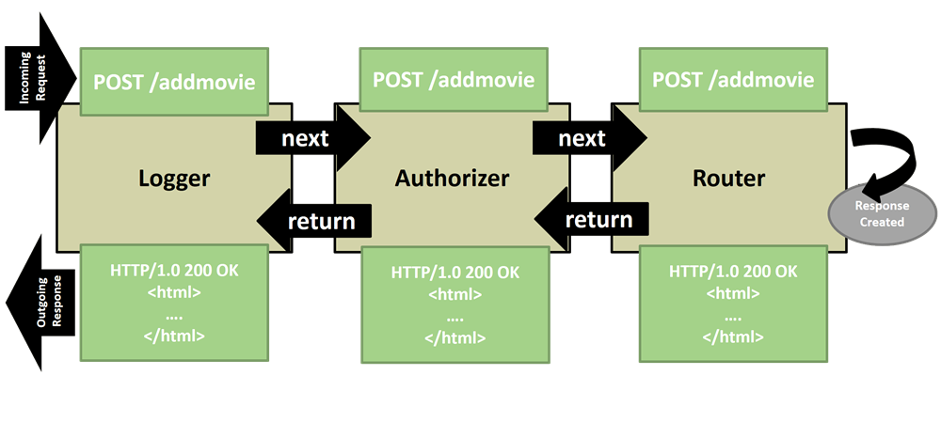
Processing HTTP Requests

Slide 26
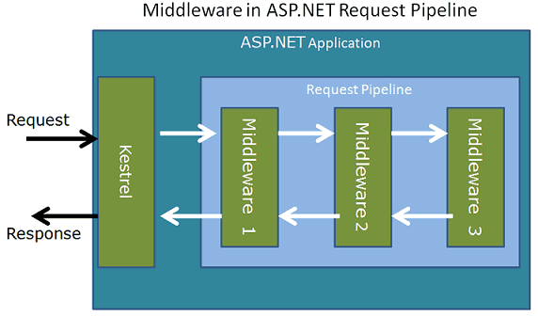
How the Middleware Works?
First, the Http Request arrives (directly or via External web server)
The Kestrel Web server picks up the Request and creates the httpContext and passes it to the First Middleware in the request pipeline
The First Middleware then takes over, process the request and passes it to the next Middleware. This goes on until it reaches the last middleware.
The last middleware returns the request back to the previous middleware, effectively terminating the request pipeline.
Each middleware in the sequence gets a second chance to inspect the request and modify the response on its way back.
Finally, the response reaches kestrel, which returns the response back to the client
Any of the middleware in the request pipeline can terminate the request pipeline by simply not passing the request to the next middleware

Slide 27
Configuring Middleware
To start using any Middleware, we need to add it to the Request pipeline.
This is done in the Configure method of the startup class. Most middleware will live in a NuGet package.
The Configure method gets the instance of IApplicationBuilder, using which we can register our Middleware

Slide 28
Configure Middleware with Use and Run
The Use and Run method extensions allow us to register the Inline Middlewares to the Request pipeline.
The Run method adds the terminating middleware.
The Use method adds the middleware, which may call the next middleware in the pipeline
The app.Use gets two arguments. One is HttpContext and the second one is a RequestDelegate, which is basically the reference to the next middleware.

Slide 29
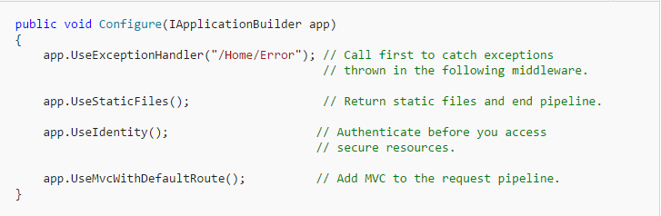
Configuring Middleware
The order that middleware components are added in the Configure method defines the order in which they are invoked on requests, and the reverse order for the response.

Slide 30
Built-in middleware
Middleware | Description
Authentication | Provides authentication support.
CORS | Configures Cross-Origin Resource Sharing.
Response Caching | Provides support for caching responses.
Response Compression | Provides support for compressing responses.
Routing | Defines and constrains request routes.
Session | Provides support for managing user sessions.
Static Files | Provides support for serving static files and directory browsing.
URL Rewriting Middleware | Provides support for rewriting URLs and redirecting requests.

Slide 31
Creating Middleware
First, Invoke will receive an HttpContext object with access to the request and the response.
You can inspect incoming headers and create outgoing headers.
You can read the request body or write into the response.
The logic inside Invoke can decide if you want to call the next piece of middleware or handle the response entirely in the current middleware.
Note the name Invoke is the method ASP.NET will automatically look for (no interface implementation required), and is injectable.

Slide 32
Advantages
The ability to explicitly configure every component of the HTTP processing pipeline makes it easy to know what is happening inside an application.
The application is also as lean as possible because we can install only the features an application requires.
Middleware is one reason why ASP.NET Core can perform better and use less memory than its predecessors.

Slide 33
Serving Static Files in ASP.NET Core

Slide 34
Overview
The ASP.NET Core has the ability to serve the static files such as HTML, CSS, image, and JavaScript directly to clients, without going through the MVC Middleware.

Slide 35
Serving Static Files
HTML, CSS, images, JavaScript files are called static files.
There are two ways you can serve static files in ASP.NET Core MVC. Directly or through controller Action.
The Static files are those files, whose content does not change dynamically when the user requests for it.
The ASP.NET Core provides a built-in Middleware just for this task.

Slide 36
Where is the static File
By Convention, the static files are stored in the web root (wwwroot) folder (<content-root>/wwwroot). You can change this if you wish.
Content root
The Content root is the base path of the application. All the application files such as view, controllers, pages, javascript or any files belonging to the application.
The Content root is same as the application base path for the executable hosting the app.
Webroot
The web root of an app is the directory inside the content root from where the static resources, such as CSS, JavaScript, and image files are stored.

Slide 37
Where is the static File
The static file middleware does not check if the user is authorised to view the file.
If you want to only the authorised user to access the file, then you have to store the file outside the wwwroot folder. You can then serve the file using controller action and returning a FileResult.
The Content root is same as the application base path for the executable hosting the app.

Slide 38
Serving Static Files
By default, an asp.net core application will not serve static files
The default directory for static files is wwwroot and this directory must be in the root project folder
ToThe The middleware that we need is UseStaticFiles() middleware.
Serving a default document
By defaultTo be able to serve default page we have to plug in the UseDefaultFiles() middleware in our application's request processing pipeline.
set DefaultFiles must be called before UseStaticFiles to serve the default file.
Folder The following are the default files which UseDefaultFiles middleware looks for index.htm index.html default.htm default.html
UseFileServer combines the functionality is UseStaticFiles and UseDefaultFiles

Slide 39
Environment Variable.

Slide 40
Environment Variable
There are multiple phases where an application is tested before publishing it to the real users.
These phases by convention are development
Development,
Staging,
Production.
Environment variable indicates the runtime environment in which an application is currently running.
ASP.NET Core uses an environment variables called ASPNETCORE_ENVIROMENT to indicate the run time environment.

Slide 41
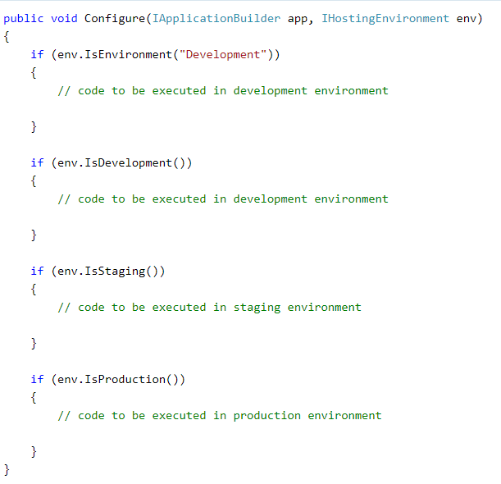
Access Environment Variable at Runtime
It is possible to get the value of an environment variable in side of the code to execute some additional code based on its value.
The IHostingEnvironment service includes Environment Name property which contains the value of ASPNETCORE_ENVIROMENT
ASP.NET Core also includes extension methods to check the environment such as IsDevelopment(), IsStating(), IsEnvironment() and IsProduction().

Slide 42
Exceptions and error handling.

Slide 43
Exceptions and error handling.
By default, ASP.NET Core returns a simple status code for any exception that occurs in an application
Handle exceptions and display messages, it needs to install Microsoft.AspNetCore.Diagnostics NuGet package and add middleware in the Configure() method.
The Microsoft.AspNetCore.Diagnostics package includes following extension methods to handle exceptions in different scenario:
UseDeveloperExceptionPage
UseExceptionHandler
TheUseDeveloperExceptionPage extension method adds middleware into the request pipeline which displays developer friendly exception detail page.
TheUseDeveloperExceptionPage helps developers in tracing errors that occur during development phase.
UseExceptionHandler extension method allows to configure custom error handling route.
UseExceptionHandler is useful when an application runs under production environment.

